Slide 1
Data Science
Unit-VI
Bayes' Classifier

Slide 2
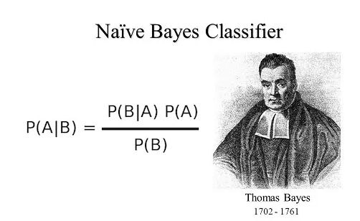
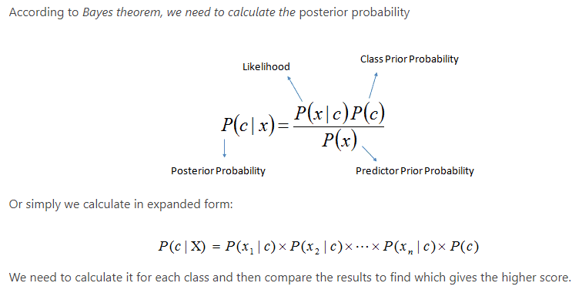
Bayes' Classifier

Slide 3
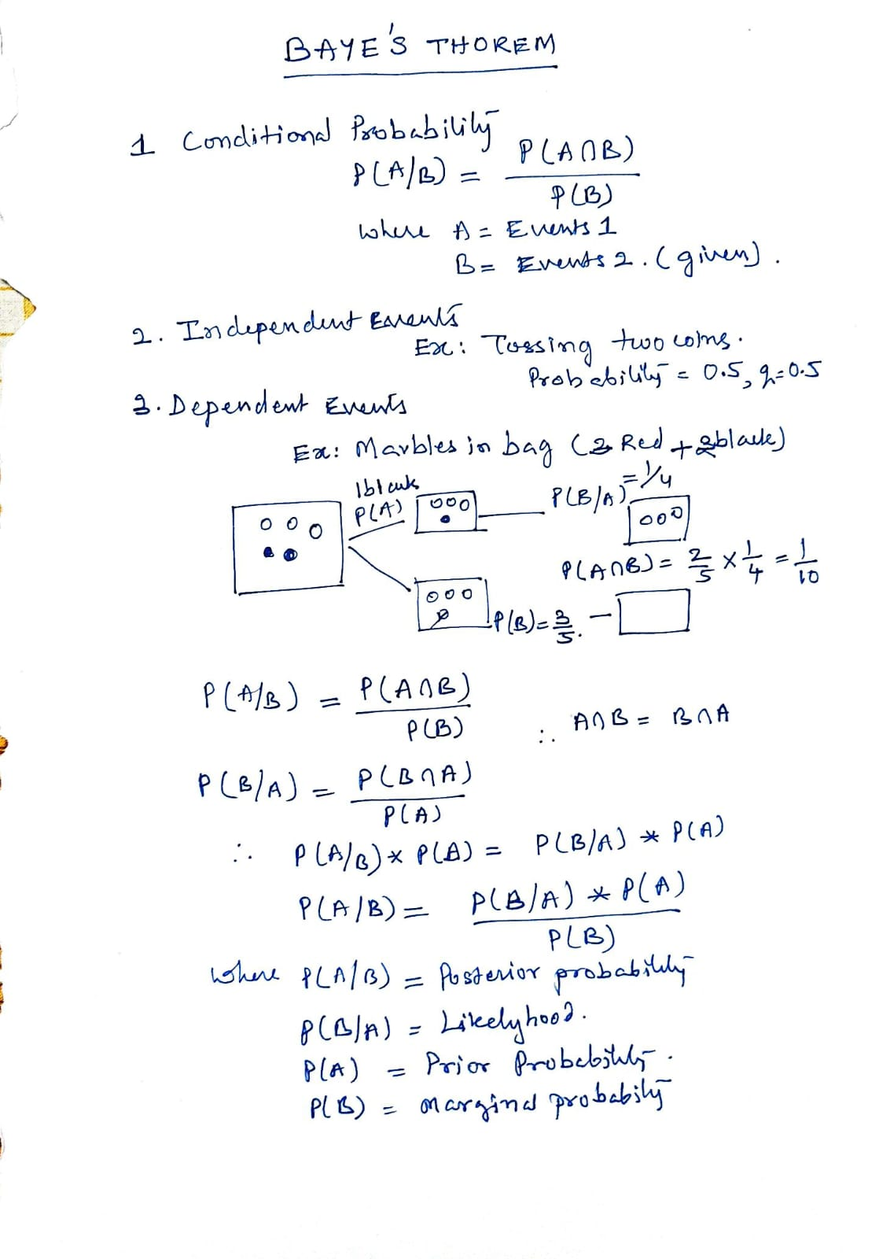

Slide 4
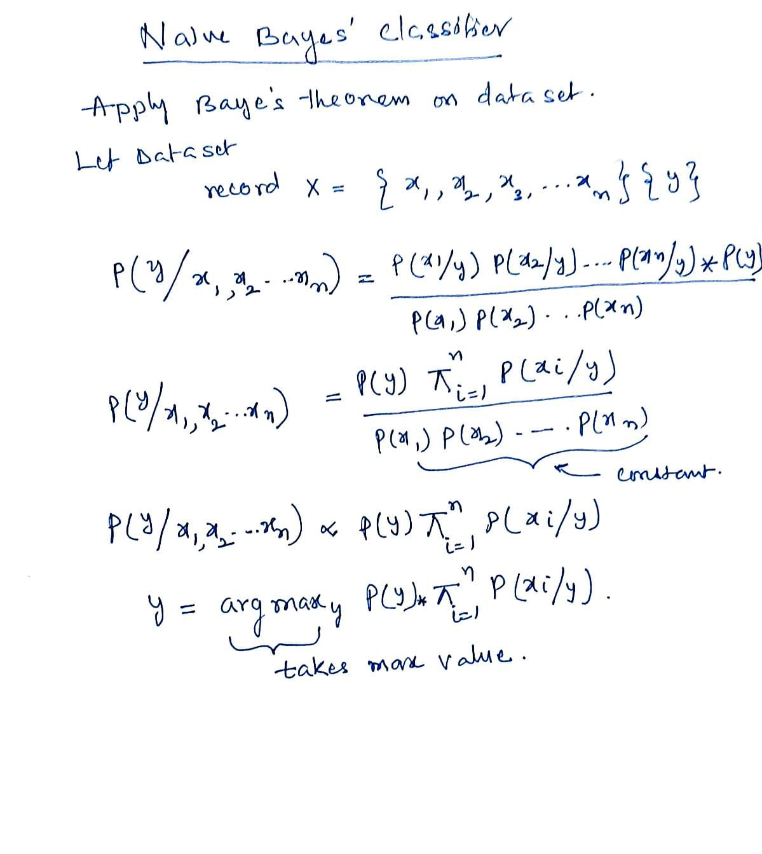

Slide 5
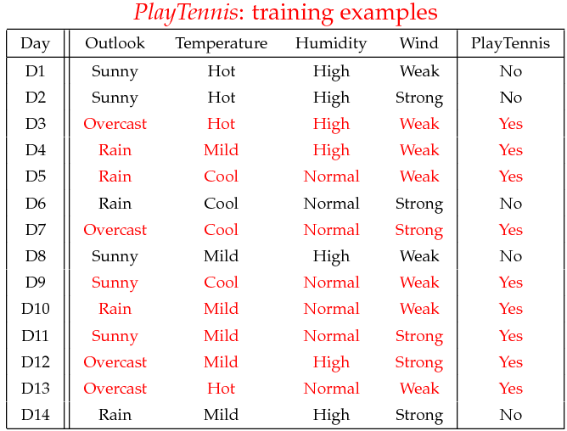
Example

Slide 6
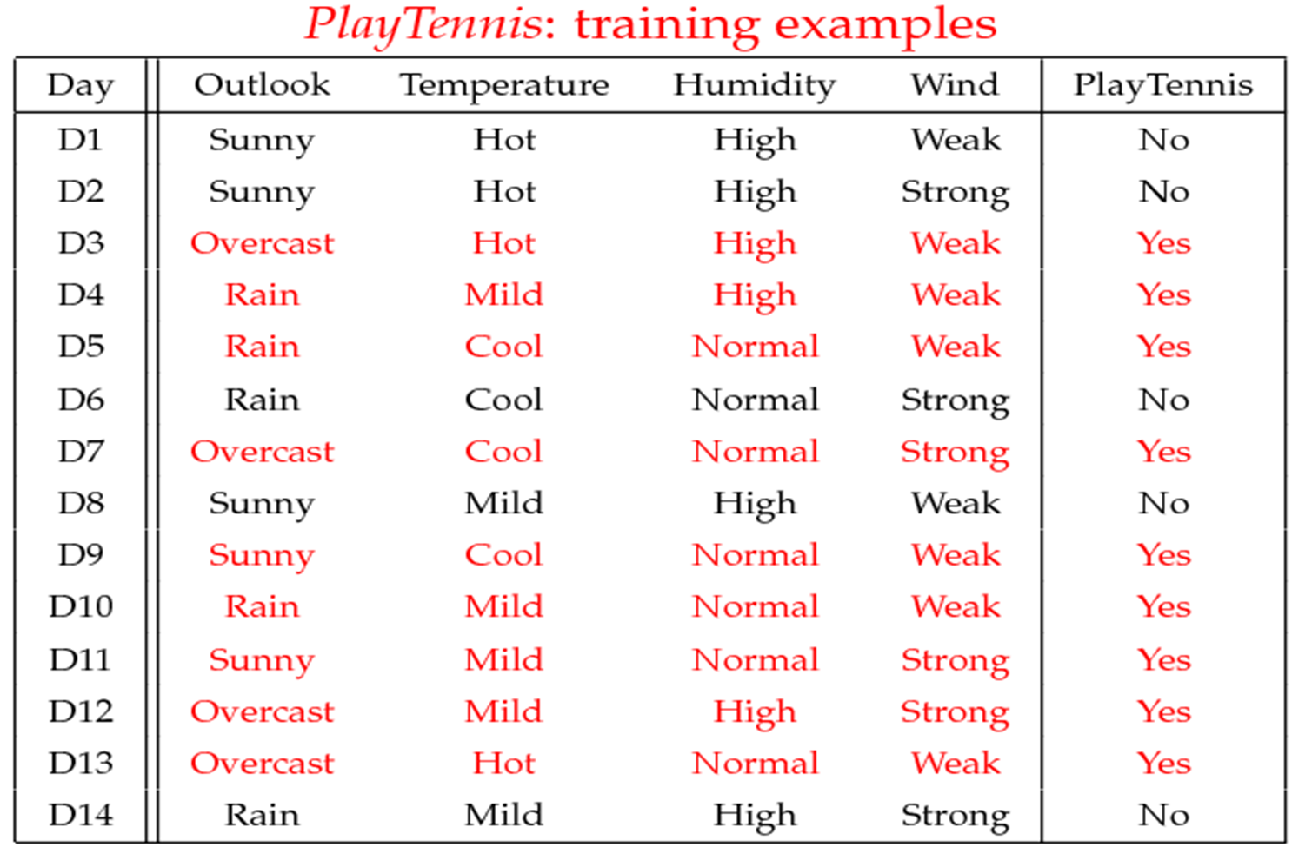
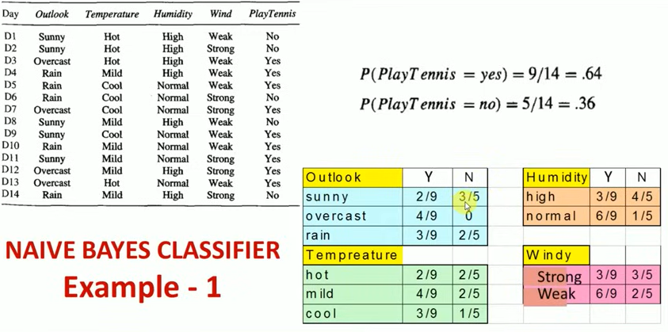

Slide 7
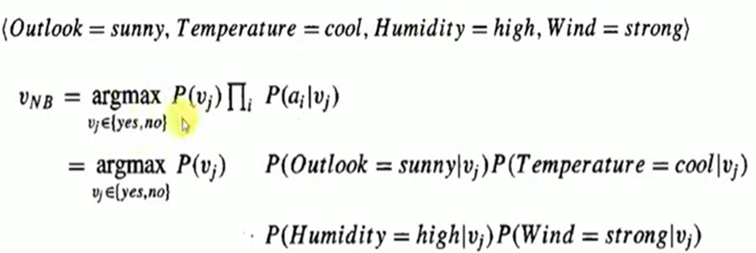
Example
Test Phase: Predict class for instance
Given a new instance,
x’=(Outlook=Sunny, Temperature=Cool, Humidity=High, Wind=Strong)
Look up tables
MAP rule
P(Outlook=Sunny|Play=Yes) = 2/9
P(Temperature=Cool|Play=Yes) = 3/9
P(Huminity=High|Play=Yes) = 3/9
P(Wind=Strong|Play=Yes) = 3/9
P(Play=Yes) = 9/14
P(Outlook=Sunny|Play=No) = 3/5
P(Temperature=Cool|Play==No) = 1/5
P(Huminity=High|Play=No) = 4/5
P(Wind=Strong|Play=No) = 3/5
P(Play=No) = 5/14
P(Yes|x’): [P(Sunny|Yes)P(Cool|Yes)P(High|Yes)P(Strong|Yes)]P(Play=Yes) = 0.0053
P(No|x’): [P(Sunny|No) P(Cool|No)P(High|No)P(Strong|No)]P(Play=No) = 0.0206
Given the fact P(Yes|x’) < P(No|x’), we label x’ to be “No”.

Slide 8
Bayesian Classification: Why?
A statistical classifier: performs probabilistic prediction, i.e., predicts class membership probabilities
Foundation: Based on Bayes’ Theorem.
Performance: A simple Bayesian classifier, naïve Bayesian classifier, has comparable performance with decision tree and selected neural network classifiers
Incremental: Each training example can incrementally increase/decrease the probability that a hypothesis is correct — prior knowledge can be combined with observed data
Standard: Even when Bayesian methods are computationally intractable, they can provide a standard of optimal decision making against which other methods can be measured

Slide 9
Bayes’ Theorem: Basics
Total probability Theorem:
Bayes’ Theorem:
Let X be a data sample (“evidence”): class label is unknown
Let H be a hypothesis that X belongs to class C
Classification is to determine P(H|X), (i.e., posteriori probability): the probability that the hypothesis holds given the observed data sample X
P(H) (prior probability): the initial probability
E.g., X will buy computer, regardless of age, income, …
P(X): probability that sample data is observed
P(X|H) (likelihood): the probability of observing the sample X, given that the hypothesis holds
E.g., Given that X will buy computer, the prob. that X is 31..40, medium income

Slide 10
Prediction Based on Bayes’ Theorem
Given training data X, posteriori probability of a hypothesis H, P(H|X), follows the Bayes’ theorem
Informally, this can be viewed as
posteriori = likelihood x prior/evidence
Predicts X belongs to C_{i} iff the probability P(C_{i}|X) is the highest among all the P(C_{k}|X) for all the k classes
Practical difficulty: It requires initial knowledge of many probabilities, involving significant computational cost

Slide 11
Classification Is to Derive the Maximum Posteriori
Let D be a training set of tuples and their associated class labels, and each tuple is represented by an n-D attribute vector X = (x₁, x₂, …, x_{n})
Suppose there are m classes C₁, C₂, …, C_{m}.
Classification is to derive the maximum posteriori, i.e., the maximal P(C_{i}|X)
This can be derived from Bayes’ theorem
Since P(X) is constant for all classes, only
needs to be maximized

Slide 12
Naïve Bayes Classifier
A simplified assumption: attributes are conditionally independent (i.e., no dependence relation between attributes):
This greatly reduces the computation cost: Only counts the class distribution
If A_{k} is categorical, P(x_{k}|C_{i}) is the # of tuples in C_{i} having value x_{k} for A_{k} divided by |C_{i, D}| (# of tuples of C_{i} in D)
If A_{k} is continous-valued, P(x_{k}|C_{i}) is usually computed based on Gaussian distribution with a mean μ and standard deviation σ
and P(x_{k}|C_{i}) is

Slide 13
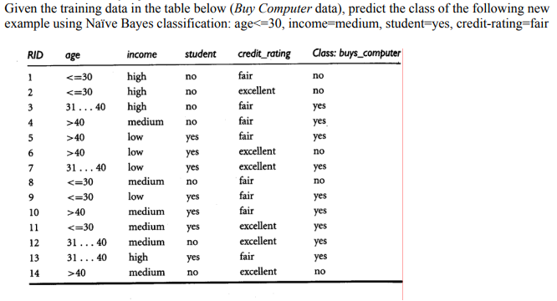
Naïve Bayes Classifier: Training Dataset
Class:
C1:buys_computer = ‘yes’
C2:buys_computer = ‘no’
Data to be classified:
X = (age <=30,
Income = medium,
Student = yes
Credit_rating = Fair)

Slide 14
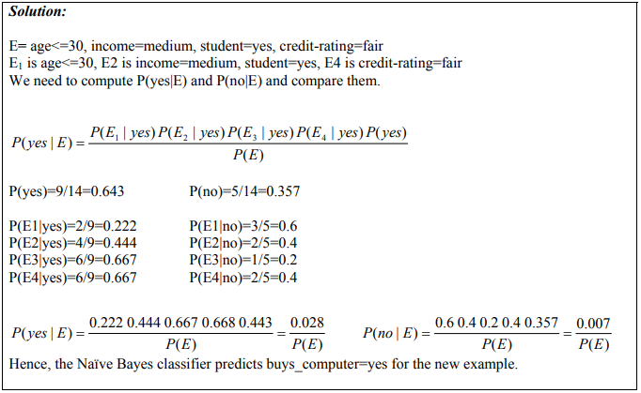
Naïve Bayes Classifier: An Example

Slide 15
Avoiding the Zero-Probability Problem
Naïve Bayesian prediction requires each conditional prob. be non-zero. Otherwise, the predicted prob. will be zero
Ex. Suppose a dataset with 1000 tuples, income=low (0), income= medium (990), and income = high (10)
Use Laplacian correction (or Laplacian estimator)
Adding 1 to each case
Prob(income = low) = 1/1003
Prob(income = medium) = 991/1003
Prob(income = high) = 11/1003
The “corrected” prob. estimates are close to their “uncorrected” counterparts

Slide 16
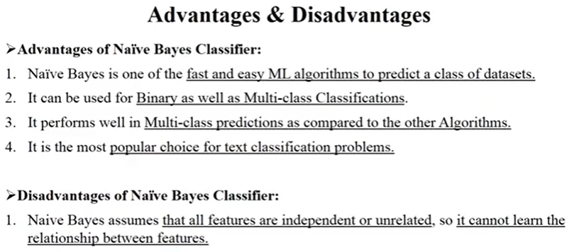

Slide 17
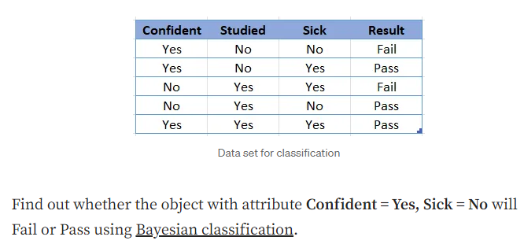
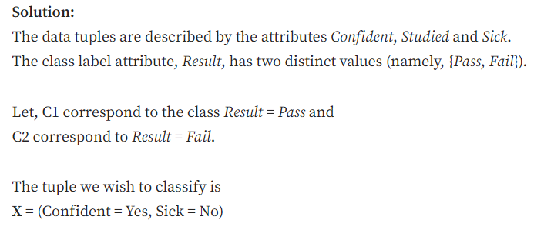
Baye’s Classifier-Example

Slide 18
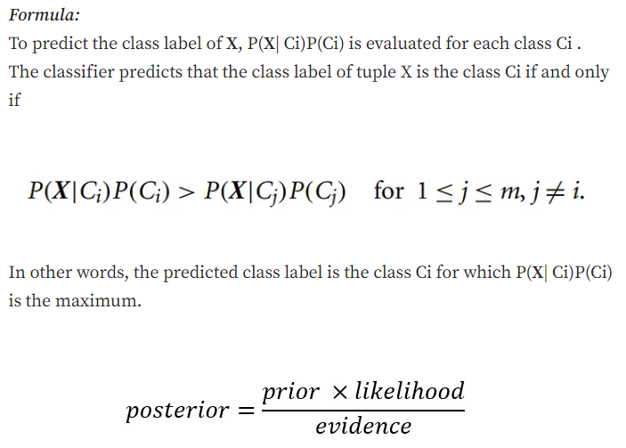
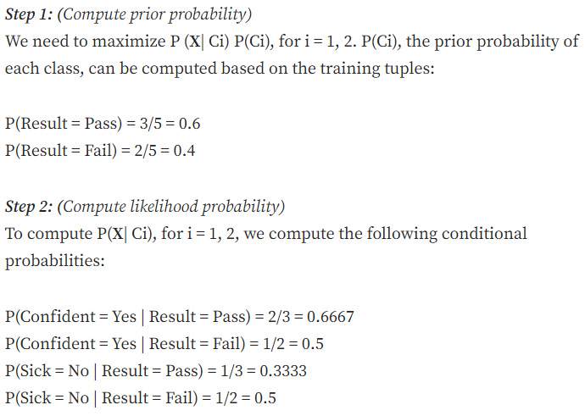

Slide 19
